Slide 1
Context-Aware Wireless Sensor Networks for Assisted Living and Residential Monitoring
Anthony D. Wood, John A. Stankovic, Gilles Virone, Leo Selavo, Zhimin He, Qiuhua Cao, Thao Doan, Yafeng Wu, Lei Fang, and Radu Stoleru
University of Virginia
Network, IEEE , vol.22, July-Aug. 2008
Presented By:
Sidhartha
Rahul

Slide 2
Agenda
Need for assisted living environments
Introduction to AlarmNet
Contributions of AlarmNet
Related Work
Architecture
Circadian Activity Rhythm
SenQ
Context Aware Power Management
Dynamic Privacy Management

Slide 3
Need for Assisted Living Systems
Aging Population
Rising cost of medical care
Shortage of full time medical professionals
Expense of high end of medical devices
Human Error in collecting data

Slide 4
Introduction
Key features of AlarmNet
a novel system for assisted living and residential monitoring
Two-way flow of data and analysis between the front and back-ends to enable context-aware protocols
Circadian Activity Rhythm analysis
SenQ query protocol
Context-aware power management
Dynamic privacy policies

Slide 5
Contributions: AlarmNet
Extensible heterogeneous network middleware
Addresses challenges of ad hoc wide scale deployment
Integrates embedded devices, back-end systems, online analysis, user interfaces
SenQ query protocol
Efficiently streaming online sensor data to system and users
Context-aware protocols using two-way network information flow
Environmental, system, resident data flow into the back-end
Circadian activity rhythm (CAR) analysis feeds back into the system to enable smart power management
Dynamic alert-driven privacy tailored to an individual’s activity patterns

Slide 6
Related Work
University of Rochester’s Smart Medical Home
Five-room lab outfitted with infrared sensors, computers, biosensors, and video cameras
MIT’s PlaceLab
One bed-room condominium fixed with sensors
Code-Blue at Harvard
Pre-hospital and in-hospital emergency care and disaster response
AlarmNet combines the ubiquitous sensing of PlaceLab with the medical focus of CodeBlue
An assisted-living context where long-term behavior and pathologies are learned

Slide 7
The AlarmNet Architecture
Heterogeneous devices in a common system-level architecture
Mobile body networks
Emplaced sensors
AlarmGate applications
Back-end programs
User interfaces

Slide 8
Circadian Activity Rhythms
Measures rhythmic behavioral activity of residents and detects changes within these patterns
Supports context-aware protocols based on learned activity patterns
Smart heterogeneous power management
Dynamic alarm-drive privacy
Graphs provide information about activity patterns
Sleep-wake cycle
Medical hints about ADLs of the resident
Any Statistically significant deviations from learned patterns are displayed as alerts in the GUI and sent to the AlarmGate application

Slide 9
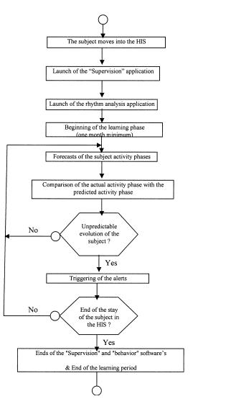
Circadian Activity Rhythms

Slide 10
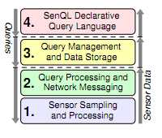
Query Management: SenQ
Multilayer embedded query system
Enables user-driven and peer-to-peer in-network query issue by wearable interfaces
Streaming queries and Snapshot queries
Spatial and temporal aggregation and filtering to reduce the energy consumed by communication

Slide 11
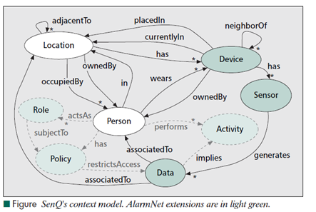
Query Management
SenQ to support query management and meet requirements
Reconfigurable in-network sensing and processing
Dynamic query origination by embedded devices
High-level abstraction for expressing queries
Queries uniquely identified by <source ID, query ID> tuples
Nodes register with nearest gateway upon powerup
Provide device type, sensors and h/w ID
Assigned dynamic network ID
Query Manager main point of
access for user interface
Translates between higher-level
query abstractions and SenQ
protocol
Dynamic semantic binding

Slide 12
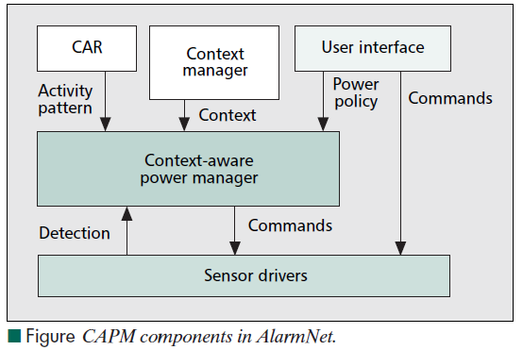
Context Aware Power Management
CAPM dynamically chooses power management operations to provide good sensing service with less energy
Based on administrator directives
Rely on context awareness
Triggers power management
operations when condition of
context policy met
Priorities used to rank importance
of commands
Context-aware power manager in
Alarm-Gate application core of
CAPM
Outputs - Set of power management commands for each sensor device in AlarmNet

Slide 13
Dynamic Context-Aware Privacy
Framework to protect privacy & still support timely assistance to residents
Dynamically adjustable to context
Allows data access authorization
to be evaluated at runtime
Adaptable to emergencies
Privacy policies at different levels
of granularity
Privacy management framework
three functional components
Context Manager
Request Authorizer
Auditor

Slide 14
Conclusions
AlarmNet - A wireless sensor network system designed for long-term health monitoring in assisted living environments
System operation adapts to the individual context and behavior patterns of the residents
Feed back to influence power management and privacy policy enforcement
System supports a diverse collection of sensors, user interfaces, and power and privacy policies

